Slide 1

Healthy Weight on FHIR CDC Analytics Reporting Application
Team-Too Deliverable 4: Final Report
Notes:
Hi My name is David Stevens
Team Too would like to provide a Final Report on the CDC analytics reporting application

Slide 2




Project Goal: Develop application to better understand and prevent childhood obesity
Care Manager
Used by care manager to manage physician referrals
Patient
Provider
Used by patients to track behaviors relevant to obesity
Used by physicians to track and interpret patient data
Analytics & Reporting
Aggregates collected data and analyzes at a population level
Developed by
Team Too
Notes:
Our project is to develop the analytics & reporting component of the CDC application focused on understanding and preventing childhood obesity
This component of the tool is used to aggregate population level data and present a flexible dashboard for providers and care managers.

Slide 3
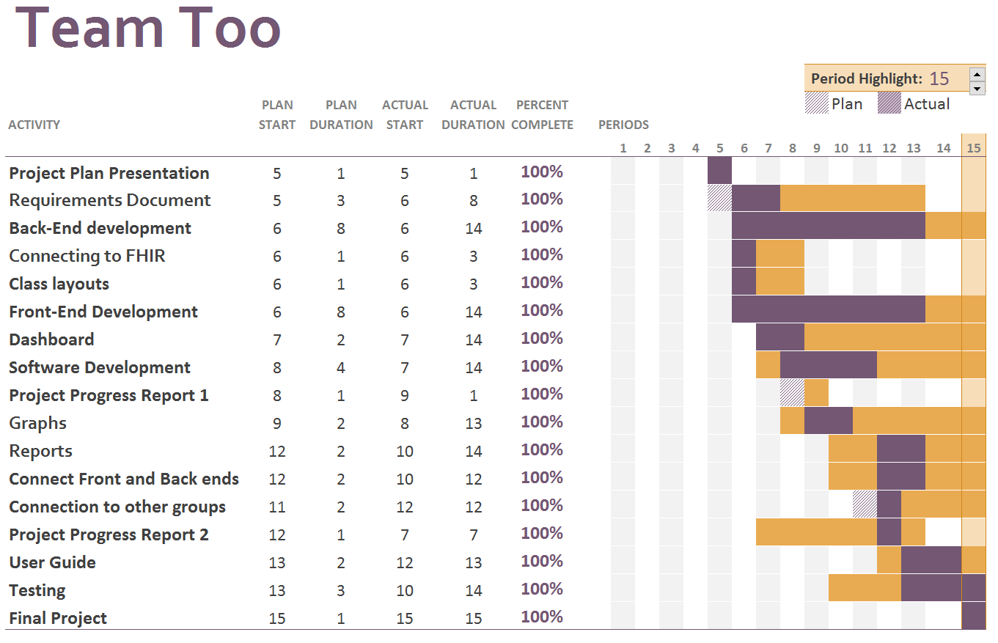
Development -- Gantt Chart
Notes:
The final Gantt chart for the Project. Project schedule and deliverable dates were met

Slide 4
Architectural Design
Highcharts
Javascript charts for GUI
Non-commercial licenses available
AngularJS
Framework for client-side model-view
controller architecture
Frontend
Fast Healthcare Interoperability Resources (FHIR) server
Primary content resource for the application
Backend
HL7.FHIR C# library
Plugin to simply database access
Notes:
The Dashboard is constructed using Highcharts and AngularJS for the front end. This allows for a lightweight, responsive design.
The Backend has been developed in C# and uses dot Net HL7 FHIR library to connect with the FHIR server. The Library simplifies working with the server since it conforms to the current FHIR specification.
Ultimately the project will be deployed as a website using Microsoft Azure services

Slide 5


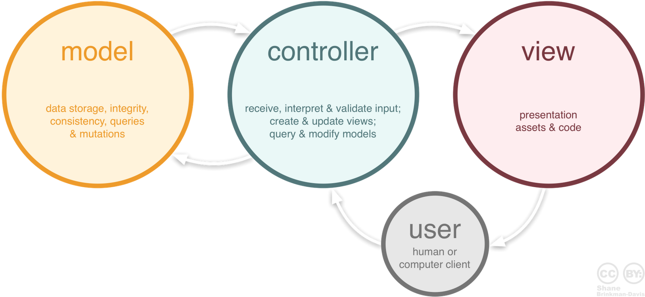
Architectural Design:
Model
Graph data classes
Patient and observation classes
Controller
Sends queries to FHIR server
Agregates and analyzes data
Creates export files
Delivers JSON payload to frontend
View
Generates visual represenation of results
Interface controls
Sends requests to controller
Notes:
The dashboard follows an MVC design template
Model includes a graph data object and patient and observation objects to store the relevant data.
The controller queries the FHIR server, and prepares the data for the frontend or data exports. The controller also delivers the data as a JSON payload to the view.
The view is the visual representation of the results and contains the user interface, triggering requests that will be sent to the controller

Slide 6
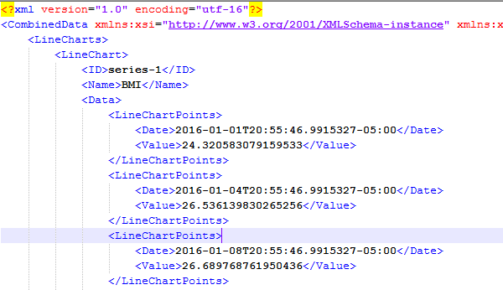
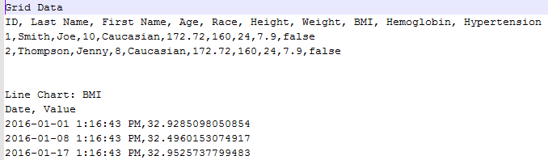
Data Export
All Results Exportable
CSV or XML Format
XML Output
CSV Output
Notes:
Easy export of the results to the common CSV and XML formats has been implemented
After selecting the desired population, a single click will generate an export including all the chart data and the individual grid data.
Similar to the grid view, sensitive data will be hidden if appropriate.

Slide 7
Final Project Development & Future Opportunities
Activities
Leveraged synthetic data for testing & validation of analytics
Improved data visualizations and formatting
Documentation
Extensibility
Source code available
Provide additional analytical functions
Customize graphical output
Notes:
In finalizing the project, we generated a collection of synthetic data to more fully test and validate the analytic components and visualizations of the tool.
Documentation for this project includes a user guide, a description of requirements and module implementation strategy, and a complete source code archive.
The Analytics and Reporting module was developed to be extensible with additional functions and graphical outputs readily included in future versions.

Slide 8
Overall Project Challenges
Data Availability
Large data set required
Needed to be generated
Georgia Tech FHIR Server
Bulk requests response capped
Slows load of data
FHIR Query Specifications
Lacks detail for complicated queries
Notes:
Overall some of the more significant challenges we faced during project development included a limited FHIR Server data set.
To properly prototype this application we needed to generate a significant amount of synthetic data.
The amount of data also gave rise to challenges when communicating with the FHIR server resulting from the server responses having a size limit, which in turn required multiple requests and reduced oveall responsiveness of the application.
Limitations in the FHIR query specification itself, for example creating queries that request subsets of value ranges, resulted in the need to query more data than required and subsequently manage the data in the application, again impacting performance.

Slide 9
Healthy Weight FHIR Suite Connectivity
Default GT FHIR:
http://polaris.i3l.gatech.edu:8080/gt-fhir-webapp/base/
Analytics & Reporting data invocation
http://cdc-obesity-dashboard.azurewebsites.net/#/ID#
Sandbox Visualization URL below:
http://cdc-obesity-dashboard.azurewebsites.net/#
Notes:
These links may be used to access the indicated components of the Healthy Weight Suite.
A demonstration video is provided at the end of this presentation follows providing a brief walkthrough of the Analytics & Reporting module capabilities and visualizations.

Slide 10
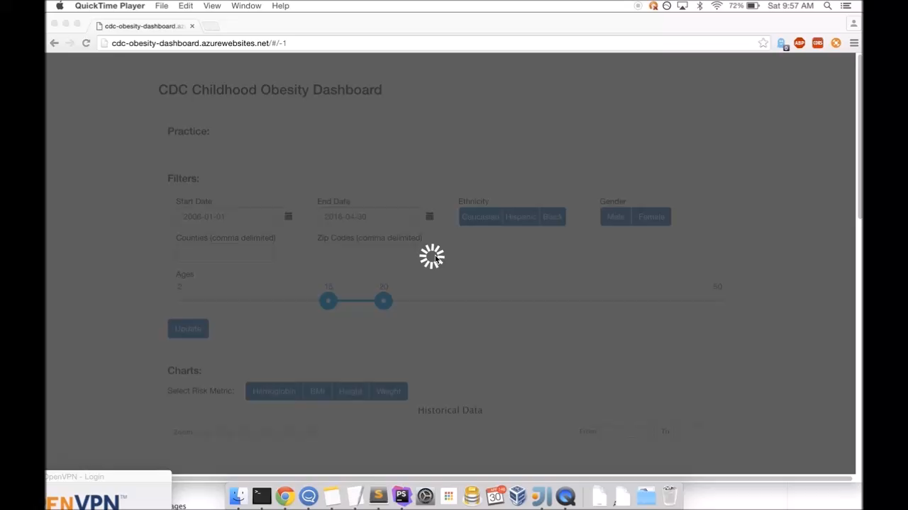
Demo Video

Slide 11
Thank You!
Project Manager
Developer
Daniel Hegberg
Data analysis & reporting
Frontend Developer
Backend Developer
David Bailey
Team-Too
David Stevens
User Interface Design
Report generation
Quality Assurance
Team Liaison
Kirk Pastorian
Research & Testing

